Slide 1

Agile Methodology
Dr. Keerthy A S

Slide 2

Agility
Agile
Primer
Manifesto
Characteristics
Daily Stand-up
Definition of Done
Release Planning
Iteration Planning
Product Backlog
.

Slide 3

Agile
Agile is
a software development methodology to
build software incrementally
using short iterations of 1 to 4 weeks
the development is aligned with the changing business needs.

Slide 4

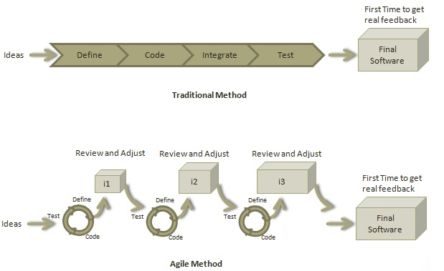
Agile - Primer
-Roles in Agile
-How an Agile Team Plans its Work?
How the Requirements are Defined?

Slide 5
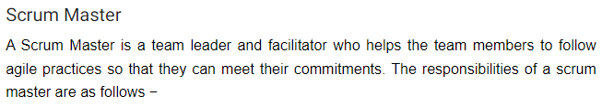
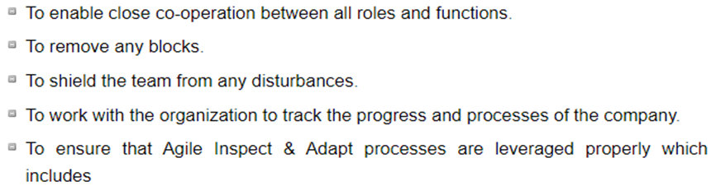
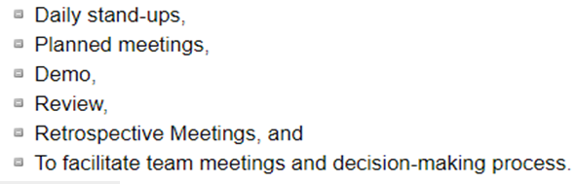
Roles in Agile
Scrum Master
Product Owner
Cross-functional Team

Slide 6
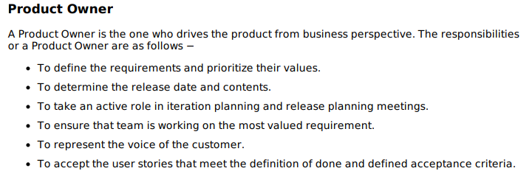
Roles in Agile
Scrum Master
Product Owner
Cross-functional Team

Slide 7
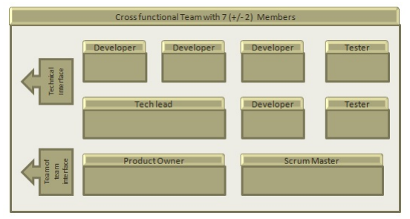
Roles in Agile
Cross-functional Team
Every agile team should be a self-sufficient team with 5 to 9 team members and an average experience ranging from of 6 to 10 years.
Scrum Master
Product Owner
Cross-functional Team
Product Owner and Scrum master are considered to be a part of Team Interface,
Other members are part of Technical Interface.

Slide 8
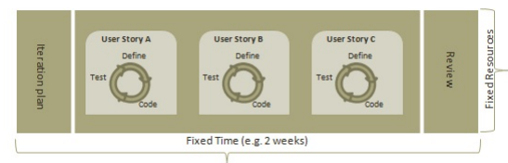
How an Agile Team Plans its Work?
An Agile team works in iterations to deliver user stories where each iteration is of 10 to 15 days.
Each user story is planned based on its backlog prioritization and size.
The team uses its capacity
how many hours are available with the team to work on tasks
to decide how much scope they have to plan.

Slide 9
How the Requirements are Defined?
A User Story,
With Acceptance Criteria, and
Tasks to implement the story.

Slide 10
How an Agile Team Plans its Work?
Point
A Point defines how much a team can commit.
A point usually refers to 8 hours.
Each story is estimated in points.
Capacity
Capacity defines how much an individual can commit.
Capacity is estimated in hours.
What is a User Story?
A user story is a requirement that defines what is required by the user as functionality.
A user story can be in two forms
As an I want so that In order to
as I want
During release planning, a rough estimate is given to a user story using relative scale as points.
During iteration planning, the story is broken down into tasks.

Slide 11
Relationship of User Stories and Tasks
User story talks about what is to be done.
Defines what a user needs.
Talks about how it is to be done.
Defines how functionality is to be implemented.
Stories are implemented by tasks.
Each story is a collection of tasks.
User story is divided into tasks when it is planned in the current iteration.
Tasks are estimated in hours, typically from 2 to 12 hours.
Stories are validated using acceptance tests.

Slide 12
What is Acceptance Criteria?
Criteria defines
the functionality,
behavior, and
performance required by a feature so that it can be accepted by the product owner.
It defines what is to be done so that the developer knows when a user story is complete.

Slide 13
AGILE - MANIFESTO
Twelve Principles of Agile Manifesto
Customer Satisfaction
Welcome Change
Deliver a Working Software
Collaboration
Motivation
Face-to-face Conversation
Measure the Progress as per the Working Software
Maintain Constant Pace
Monitoring
Simplicity
Self-organized Teams
Review the Work Regularly

Slide 14
AGILE -- CHARACTERISTICS
Iterative/incremental and Ready to Evolve
break a problem into smaller tasks.
No direct long-term planning for any requirement.
Iterations of very short periods of time- cross-functional team
Review comments to be incorporated into the working software
Face-to-face Communication
customer representative.
Information radiator shows an up-to-date summary of the status of a project.
Feedback Loop
Daily stand-up/Daily Scrum where each team member reports regarding the status.

Slide 15
AGILE - DAILY STAND-UP
daily status meeting among all the members of an agile team.
a forum for regular updates, roughly for 15 minutes.
status update, not for any discussion
brings the problems of team members into
a must-do practice regardless of its office location.
Benefits of daily stand-up:
Evaluate the progress on a daily basis and see if they can deliver as per the iteration plan.
Each team member informs all about his/ her commitments for the day.
It provides visibility to the team on any delays or obstacles.
Participants:
Scrum master, Product owner, and delivery team - Daily

Slide 16
AGILE- DEFINITION OF DONE
User Story
All the related code have been checked-in.
All the unit test cases have been passed.
All the acceptance test cases have been passed.
Help text is written.
Product Owner has accepted the story.
Iteration/Sprint
Product backup is complete.
Performance has been tested.
User stories have been accepted or moved to the next iteration.
Defects have been fixed or postponed to the next iteration.
Release
System is stress tested.
Performance is tuned.
Security validations are carried out.
Disaster recovery plan is tested.

Slide 17
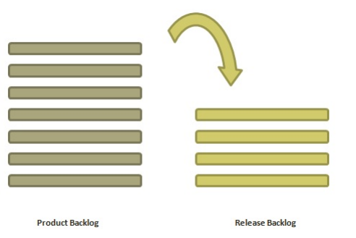
AGILE – RELEASE PLANNING
People Involved
Scrum Master
Prerequisites
A ranked product backlog
Product owner
Agile team
Stakeholders
Team's input about capabilities
High-level vision
Market and Business objective
Acknowledgement whether new product backlog items are needed
create a plan to deliver an increment to the product.
It is done after every 2 to 3 months.

Slide 18
AGILE – RELEASE PLANNING
Materials Required
Posted agenda, purpose
Flip charts, whiteboards, markers
Projector
Planning data
Planning Data
Previous iterations or release planning results
Feedback from various stakeholders on product, market conditions, and deadlines
Action plans of previous releases / iterations
Features or defects to be considered
Velocity from previous releases/ estimates.
Organizational and personal calendars
Inputs from other teams and subject matter experts

Slide 19
AGILE – RELEASE PLANNING
Output
Release plan
Commitment
Issues, concerns, dependencies, and assumptions which are to be monitored
Suggestions to improve future release plannings
Agenda
Opening ceremony
Product Vision, Roadmap
Review previous releases
Release name / theme
Velocity
Release schedule
Issues and concerns
Review and Update the Definition of Done
Stories and items to be considered
Determine sizing values
Coarse the size of stories
Map stories to iterations
New concerns or issues
Dependencies and assumptions
Commit
Communication and logistics planning
Parking lot
Distribute Action items and action plans
Retrospect
Close

Slide 20
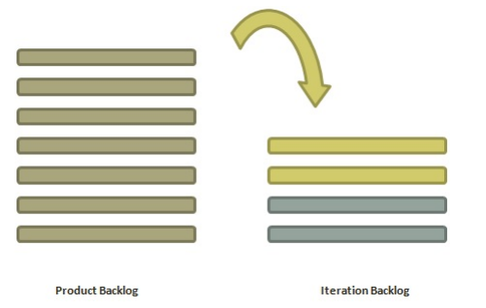
AGILE- ITERATION PLANNING
People Involved
Scrum Master
Product owner
Agile team
to complete the set of top-ranked product
backlog items
time boxed based on the length of iteration and team velocity.

Slide 21
AGILE- ITERATION PLANNING
Prerequisites
Items in product backlog are sized and have a relative story point assigned.
Ranking has been given to portfolio items by the product owner.
Acceptance criteria has been clearly stated for each portfolio item.
Planning Process
Determine how many stories can fit in an iteration.
Break these stories into tasks and assign each task to their owners.
Each task is given estimates in hours.
The estimates help team members to check how many task hours each member have for the iteration.
Team members are assigned tasks considering their velocity or capacity so that they are not overburdened.

Slide 22
AGILE- ITERATION PLANNING
Velocity Calculation
calculates velocity based on past iterations.
Velocity is an average number of units required to finish user stories in an iteration.
For example, if a team took 12, 14, 10 story points in each iteration for the last three iterations, the team can take 12 as velocity for the next iteration.
Planned velocity tells the team how many user stories can be completed in the current iteration.
If the team quickly finishes the tasks assigned, then more user stories can be pulled in.
Otherwise, stories can be moved out to the next iteration.
Task Capacity
Number of ideal working hours in a day
Available days of person in the iteration
Percentage of time a member is exclusively available for the team.

Slide 23
AGILE- ITERATION PLANNING
Planning Steps
Product Owner describes the highest ranked item of product backlog.
Team describes the tasks required to complete the item.
Team members own the tasks.
Team members estimate the time to finish each task.
These steps are repeated for all the items in the iteration.
If any individual is overloaded with tasks, then his/her task is distributed among other team members.

Slide 24
AGILE PRODUCT BACKLOG
A product backlog is a list of items to be done. Items are ranked with feature descriptions. In an
ideal scenario, items should be broken down into user stories.
Importance of Product Backlog
It is prepared so that estimates can be given to each and every feature.
It helps in planning the roadmap for the product.
It helps in re-ranking the features so that more value can be added to the product.
It helps in determining what to prioritize first.
Team ranks the item and then builds value.

Slide 25
AGILE PRODUCT BACKLOG
Characteristics of Product Backlog
Each product should have one product backlog with a set of large to very large features.
Multiple teams can work on a single product backlog.
Ranking of features is done based on business value, technical value, risk management or strategic fitness.
Highest ranking items are decomposed into smaller stories during release planning so that they can be completed in future iterations.

Slide 26

Thank You

